Slide 1
Reinforcement Learning - Part 4
孫民＆技術處

Slide 3
Misellaneous Advanced Topics with RL
System Machine Learning
DPP-Net
Anticipating Daily Intention
Show Adapt and Tell
2. 程式實作
DQN-Flappy Bird
課程內容

Slide 4
各時段預計完成內容
9:30 - 11:00 | Misellaneous Advanced Topics with RL 課程講授(optional)
11:20 - 12:30 | Challenge Time - Flappy Bird(optional)
程式碼
實作課程環境建置
講師投影片
影片播放列表
課程投影片pdf

Slide 5
Misellaneous Advanced Topics with Reinforcement Learning
理論講授

Slide 6
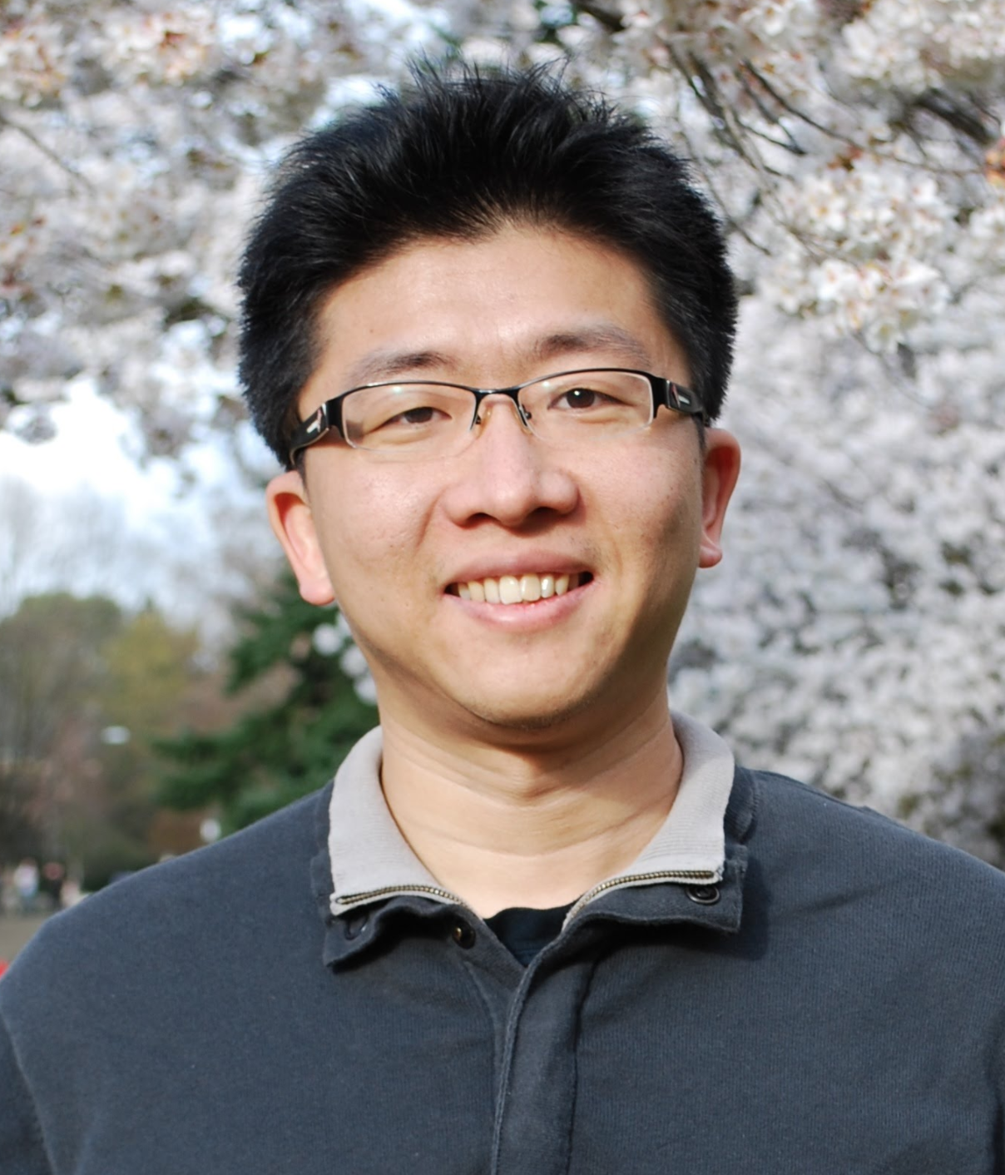
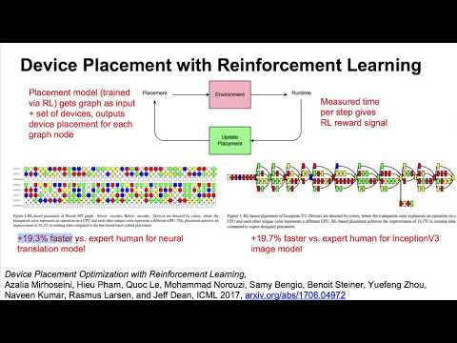
System Machine Learning

Slide 7
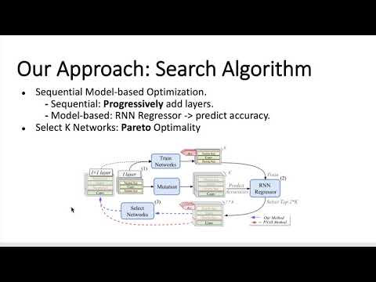
DPP-Net

Slide 8
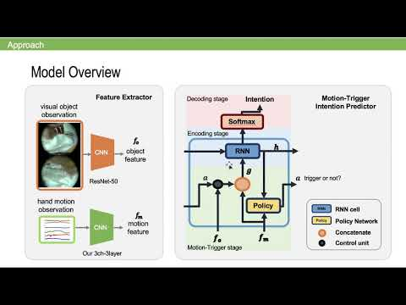
Anticipating Daily Intention by RL

Slide 9
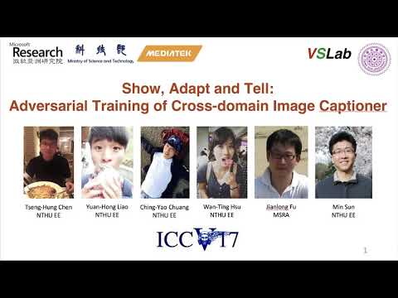
Show Adapt and Tell

Slide 10
Challenge Time - Flappy Bird (Optional)
實戰演練
Eric

Slide 11
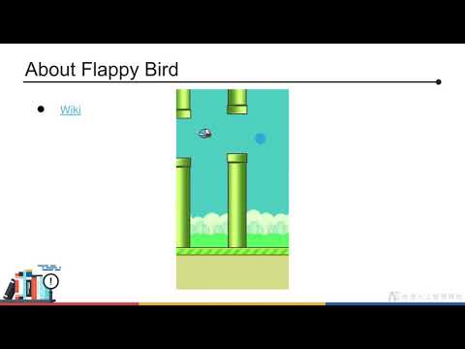
Introduction

Slide 12
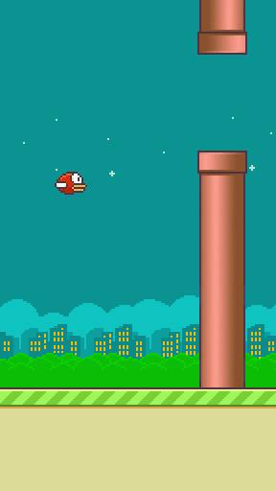
About Flappy Bird
Wiki

Slide 13
Play Flappy Bird
Install packages
pip install pygame==1.9.3
pip install tflearn==0.3.2
Play game
pythonw play_game.py
python play_game.py
Press Space Key to flap
One more round

Slide 14
Remind
Preview previous DQN courses

Slide 15
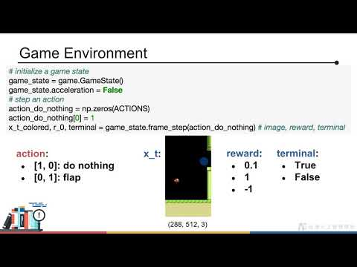
Basic Algorithms

Slide 16
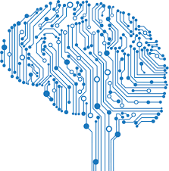

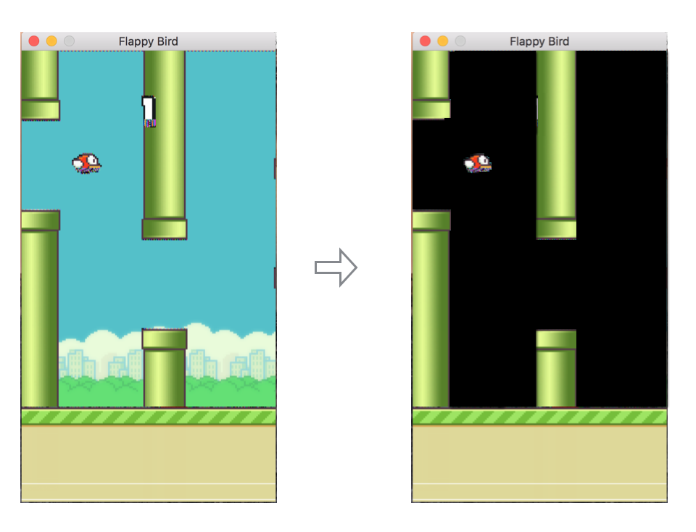
RL Recap
do nothing or flap

Slide 17
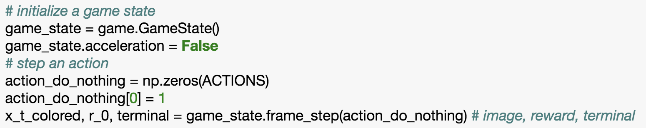
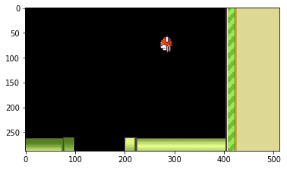
Game Environment
reward:
0.1
1
-1
action:
[1, 0]: do nothing
[0, 1]: flap
x_t:
terminal:
True
False
(288, 512, 3)

Slide 18
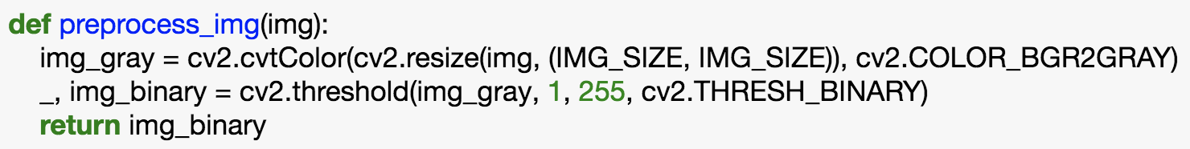
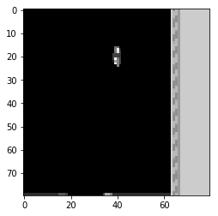
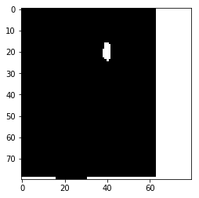
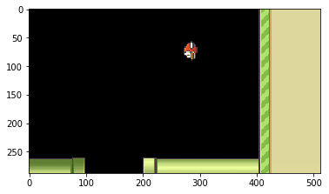
Preprocess Image
(80, 80)
(80, 80)
(288, 512, 3)

Slide 19
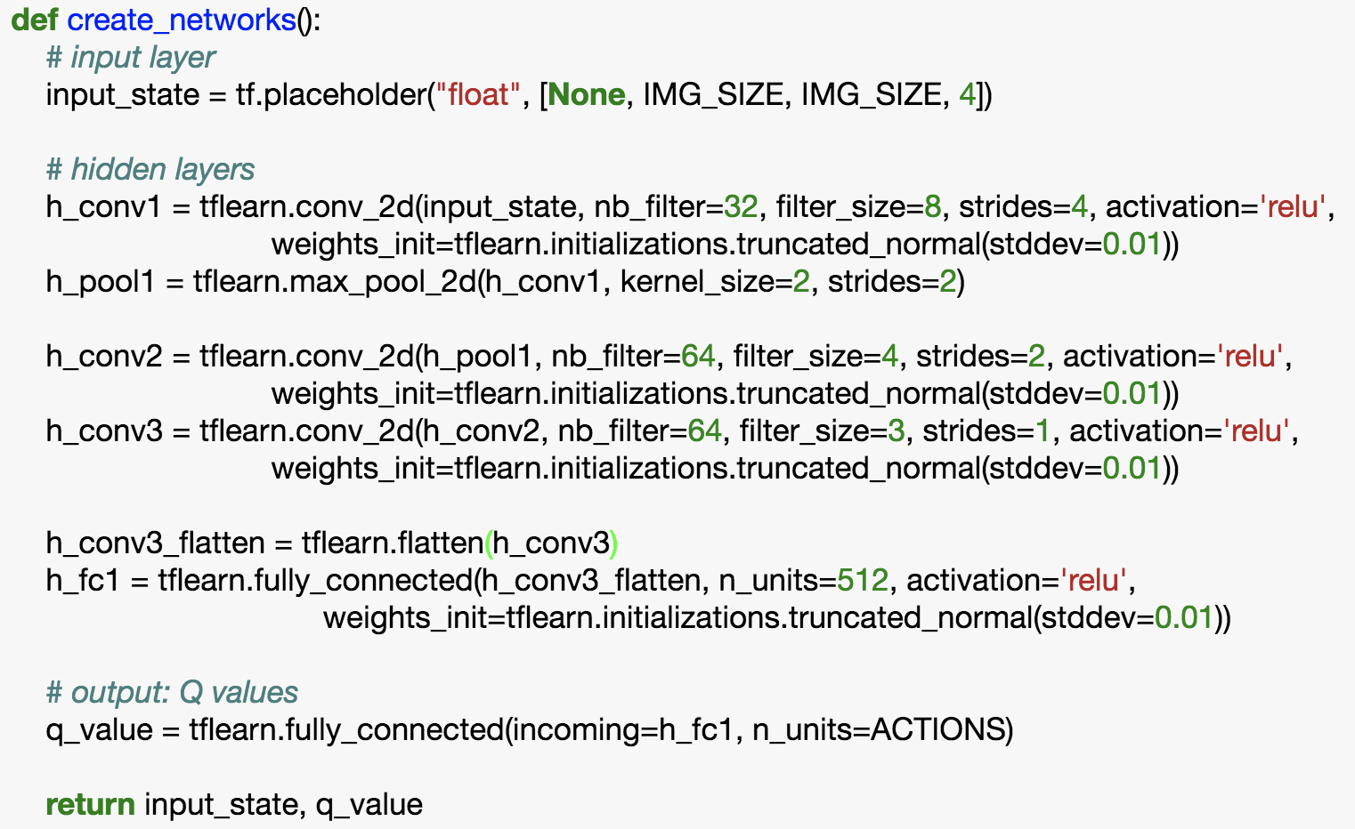
Networks

Slide 20
Networks
Conv
+
Max pooling
Conv
Conv
Flatten
FC
FC
[ Q(s, do nothing),
Q(s, flap) ]
s: (80, 80, 4)

Slide 21
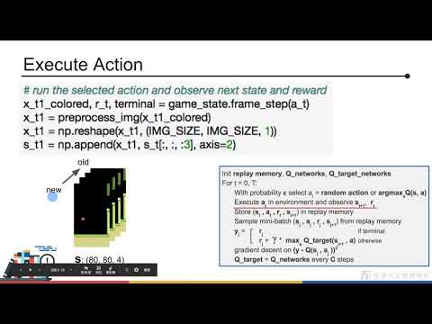
Deep Q-Learning Algorithm

Slide 22
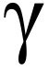
Deep Q-Learning Algorithm
Init replay memory, Q_networks, Q_target_networks
For t = 0, T:
With probability ε select a_{t} = random action or argmax_{a}Q(s, a)
Execute a_{t} in environment and observe s_{t+1}, r_{t}
Store (s_{t} , a_{t} , r_{t} , s_{t+1}) in replay memory
Sample mini-batch (s_{j} , a_{j} , r_{j} , s_{j+1}) from replay memory
y_{j} = r_{j} if terminal
r_{j} + * max_{a} Q_target(s_{j+1} , a) otherwise
gradient decent on (y - Q(s_{j} , a_{j} ))²
Q_target = Q_networks every C steps

Slide 23
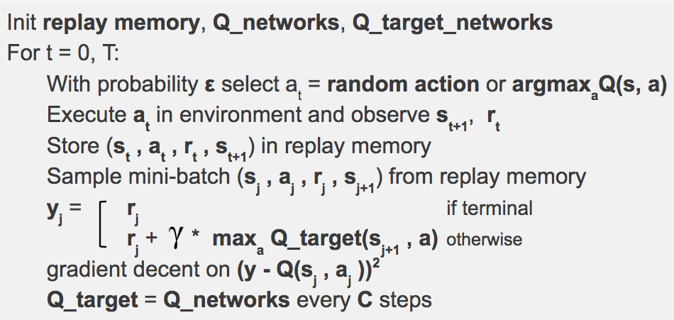
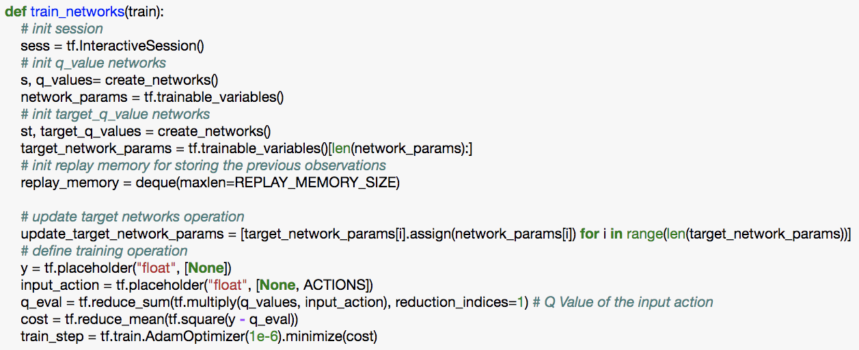
Initialization

Slide 24
Initialization

Slide 25
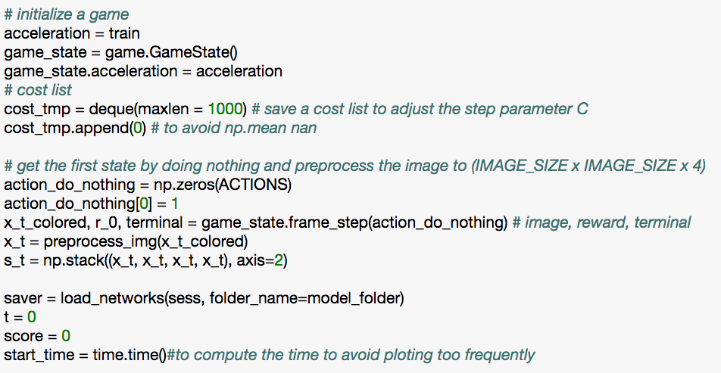
Initialization
s: (80, 80, 4)

Slide 26
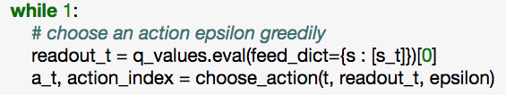
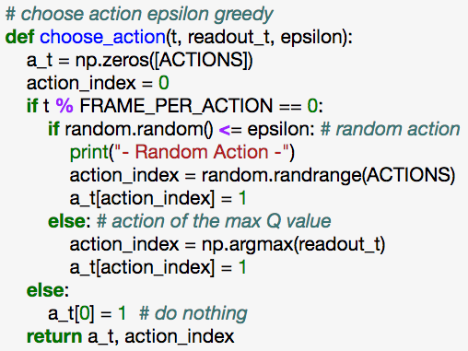
Select Action
s_{t}
NN
[Q(s, do nothing),
Q(s, flap)]

Slide 27
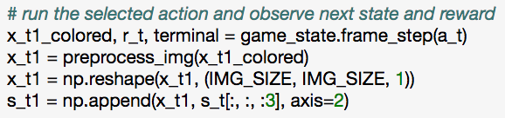
Execute Action
old
new
s: (80, 80, 4)

Slide 28
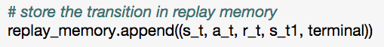
Store Transition to Replay Memory

Slide 29
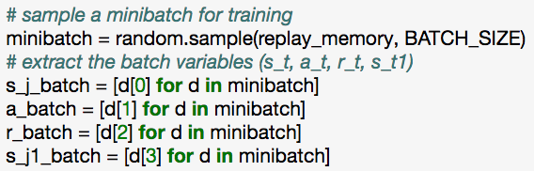
Sample mini-batch

Slide 30
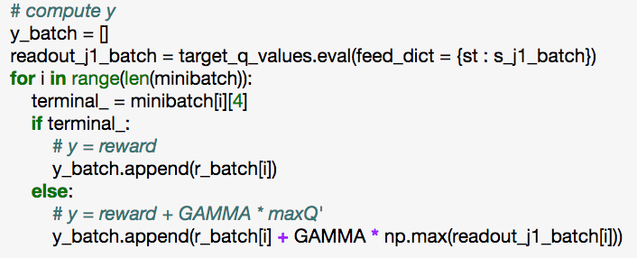
Compute y_{j}

Slide 31
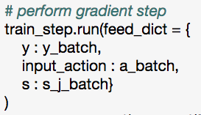
Training

Slide 32
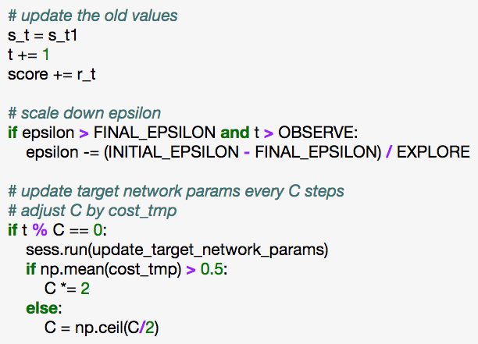
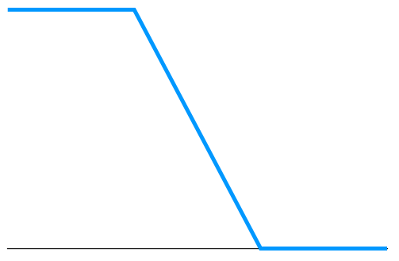
Update Networks Parameters
INITIAL_EPSILON
FINAL_EPSILON
t
OBSERVE
EXPLORE
training

Slide 33
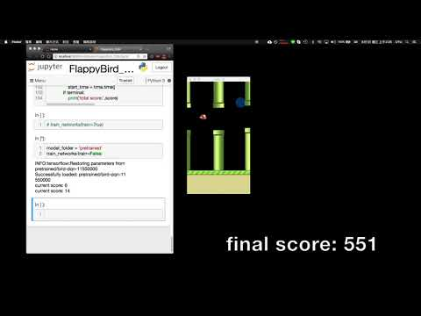
Testing

Slide 34
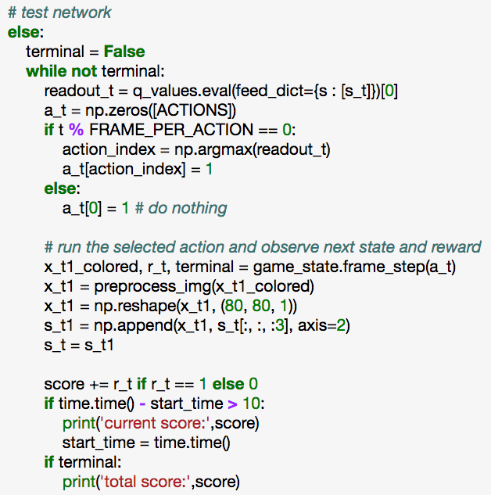
Testing

Slide 35

Summary
Use CNN to memorize Q-value instead of Q-table
2 Q-Value Networks (Q-Value, target Q-Value)
Replay memory

Slide 36
References
Using Deep Q-Network to Learn How To Play Flappy Bird
Human-level control through deep reinforcement learning

